Slide 1

TEAM 6
GEOGRAPHICALLY WEIGHTED RANDOM FOREST
CDC PLACES DATASET
By
Vaijayanti Deshmukh
1

Slide 2

AGENDA
EDA
Data Preprocessing
GWRF
Overview
Model
Implementation
Result
2

Slide 3

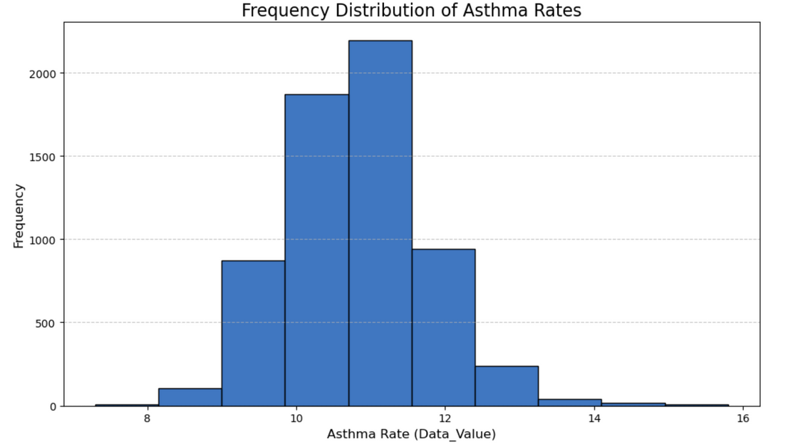
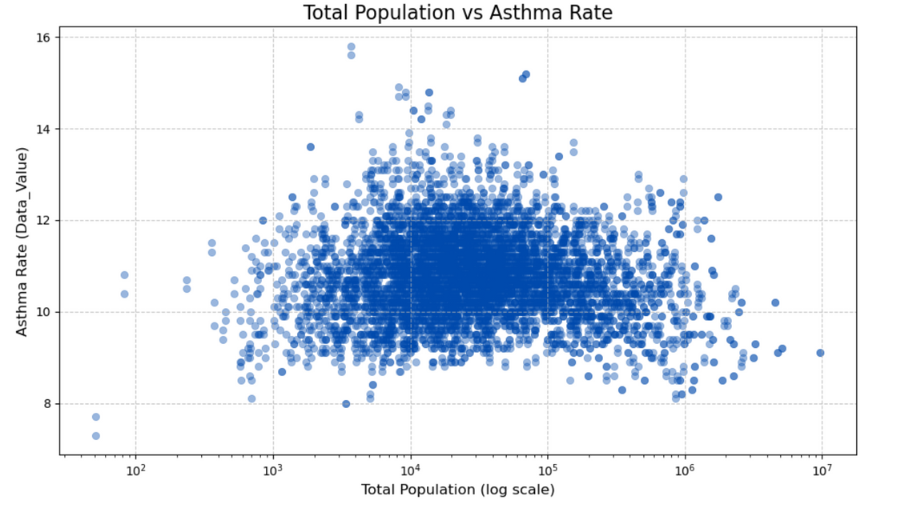
EXPLORATORY DATA ANALYSIS
Most of the points are clustered within asthma rates of approximately 10 to 12%.
There doesn’t appear to be a strong positive or negative trend between population size and asthma rate.
3

Slide 4
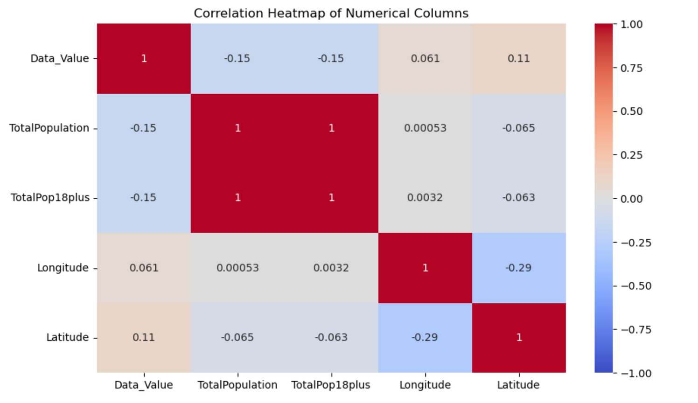
EXPLORATORY DATA ANALYSIS
Data_Value has weak correlation with all other variables, with the strongest being Latitude (0.11), indicating a very slight positive relationship.
4

Slide 5
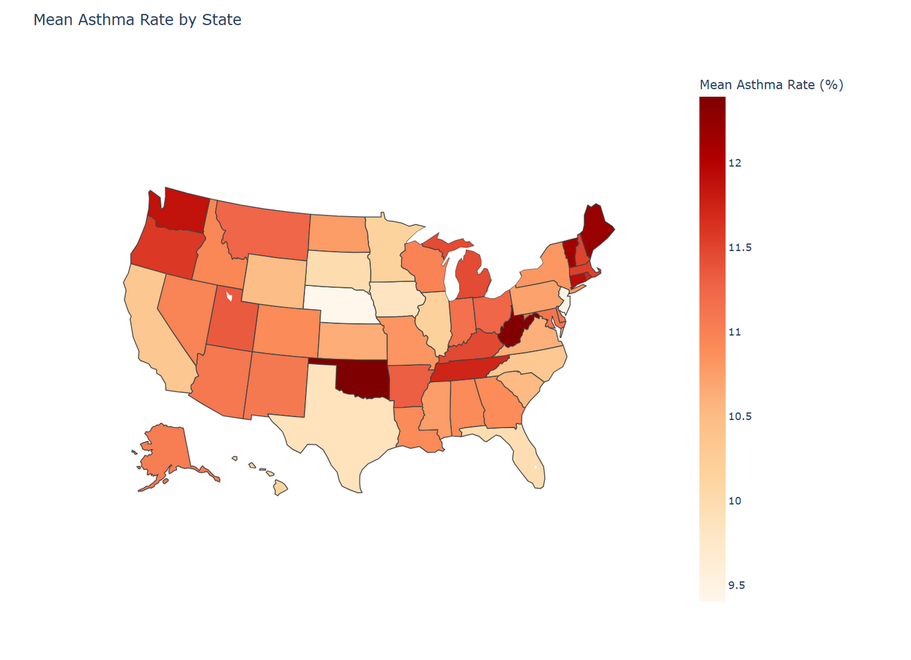
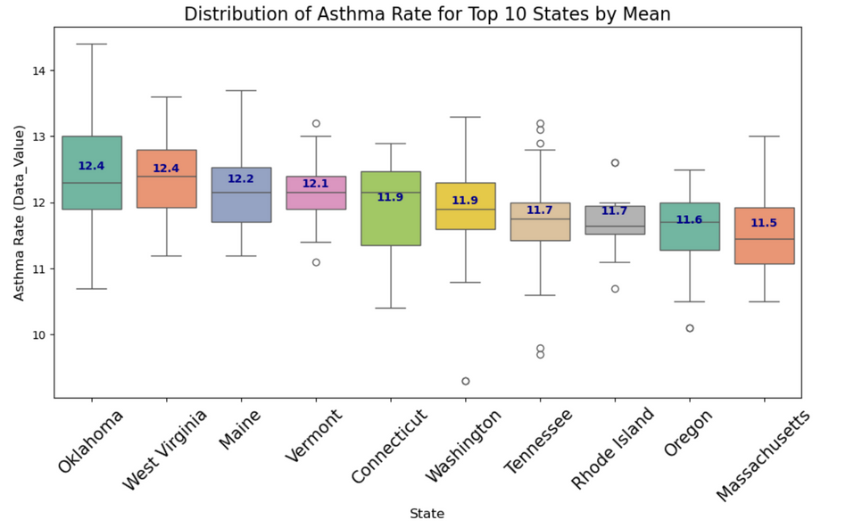
EXPLORATORY DATA ANALYSIS
The Top 10 States With The Highest Mean of Asthma Rate:
1. Oklahoma
2. West Virginia
3. Maine
4. Vermont
5. Connecticut
6. Washington
7. Tenessee
8. Rhode Island
9. Oregon
10. Massachusetts
5

Slide 6
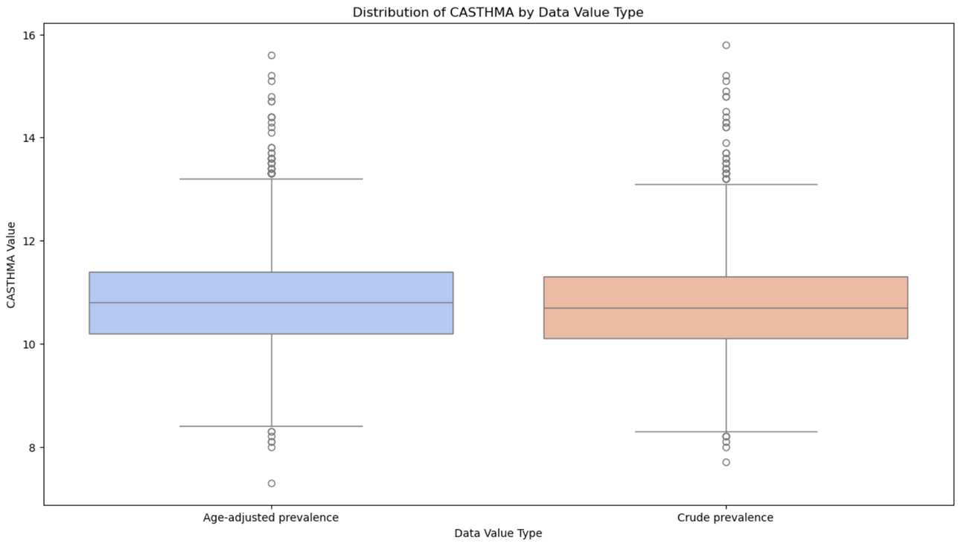
GWRF OVERVIEW
6

Slide 7
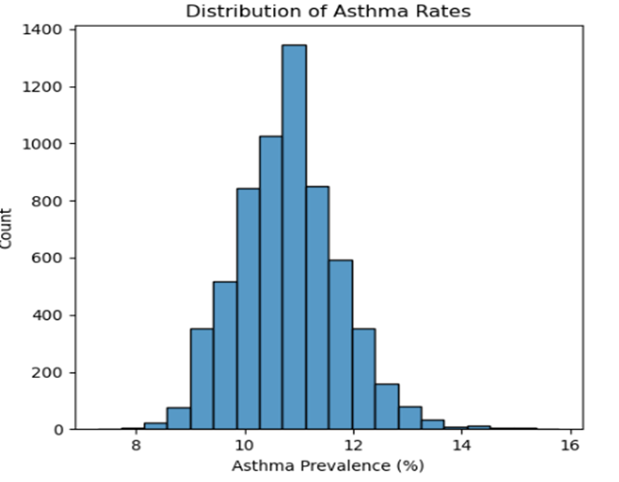
GWRF OVERVIEW
Right skewed shape with a long tail towards higher prevalence rate
The overall distribution covers a wide range of asthma prevalence from as low as 8% to 16%
7

Slide 8
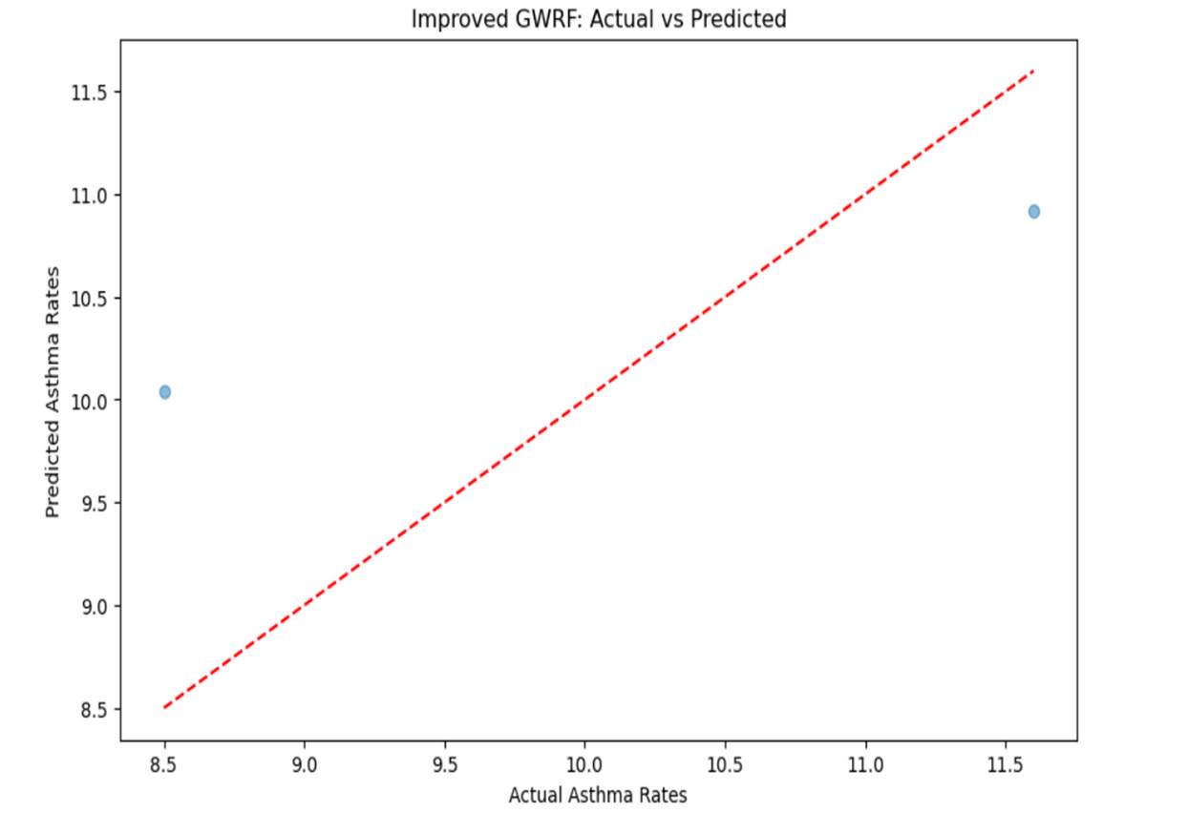
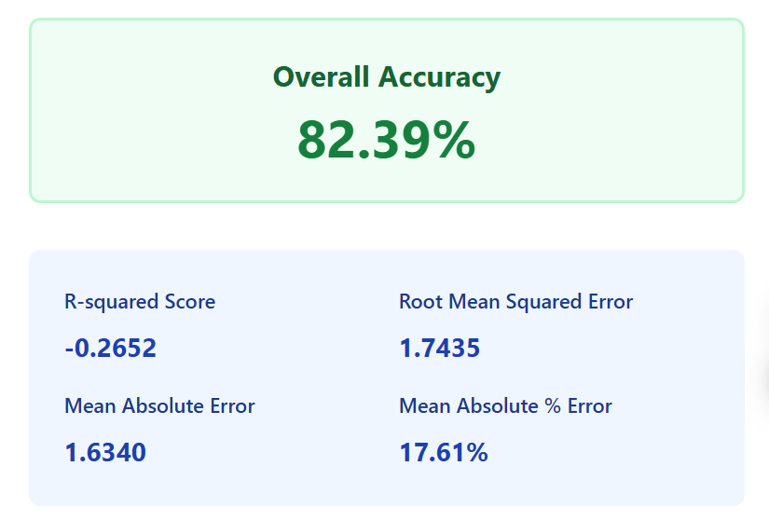
MODEL IMPLEMENTATION
Asthma Rate Prediction Model
Data Processing
Filtered CASTHMA records from CDC
dataset
Extracted geographical coordinates
Numeric conversion of asthma rates
Model Architecture
Geographically Weighted Random Forest
Gaussian distance weighting
100 estimators per forest
Training Configuration
80/20 train-test split
Random seed: 42
Location-specific model adaptation
8

Slide 9
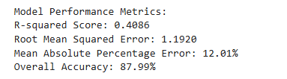
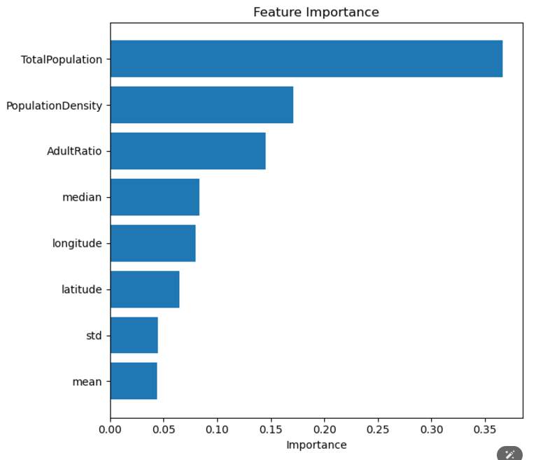
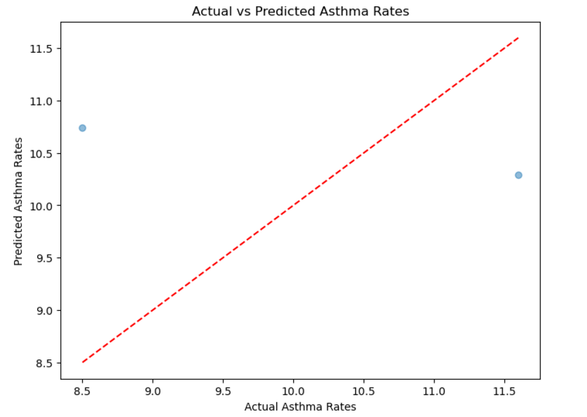
MODEL IMPLEMENTATION​
• After Applying Feature Engineering
- Population density calculation
- Adult ratio computation
- Geographic coordinates (latitude, longitude)
- State-level statistical features (mean, std)
9

Slide 10
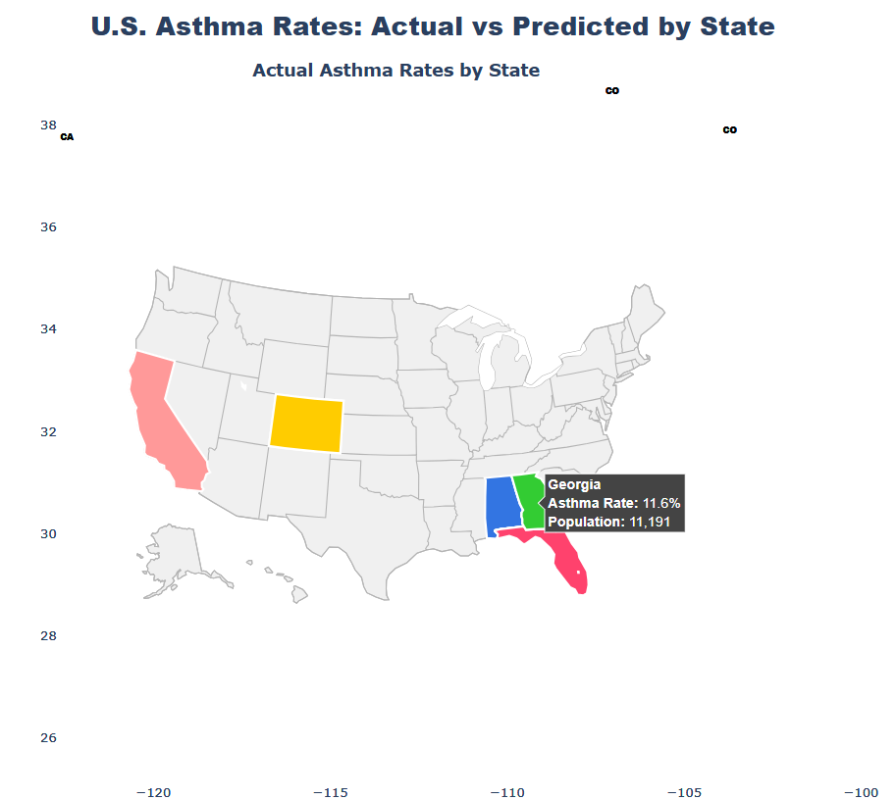
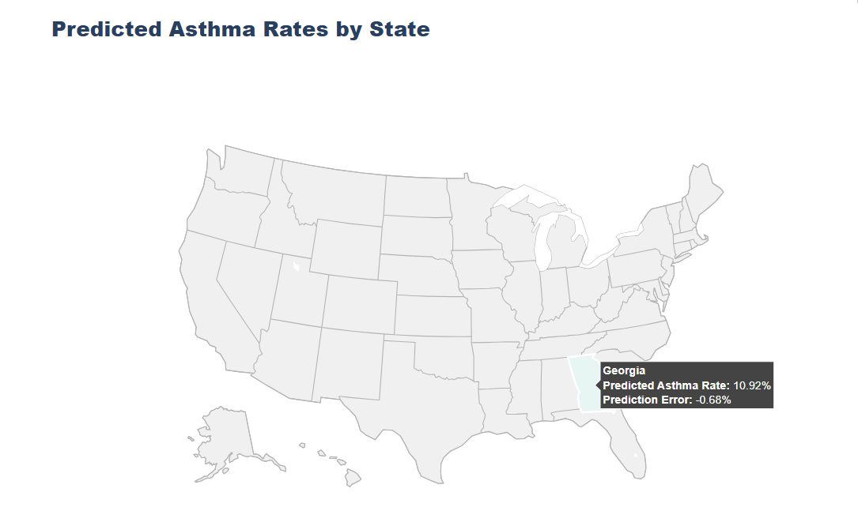
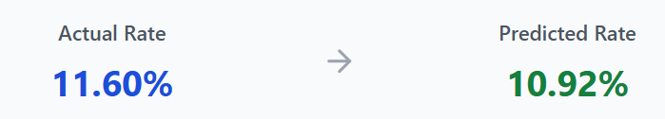
MODEL READY FOR DEPLOYEMENT
Case Study Analysis
Our Geographically Weighted Random Forest model demonstrated exceptional accuracy in predicting asthma rates for Georgia and other states as well. With a population sample of 11,191 individuals, with only a -0.68% prediction error.
This high level of accuracy validates our approach of incorporating geographical weighting and demographic factors in the prediction model. The slight underestimation suggests a conservative bias, which can be valuable for public health planning.
9

Slide 11
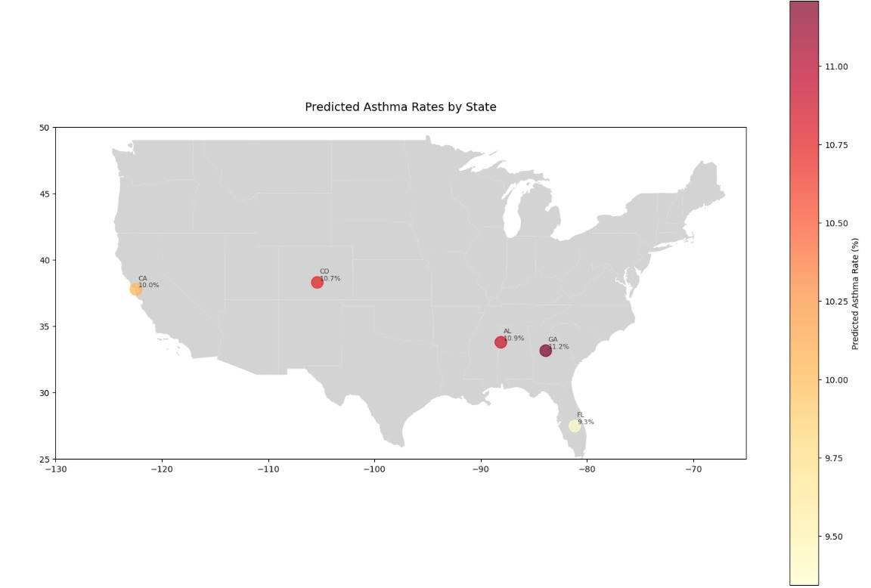
RESULTS
10

Slide 12
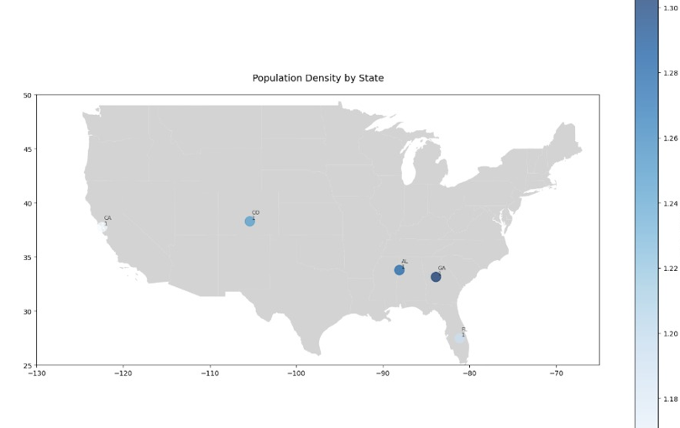
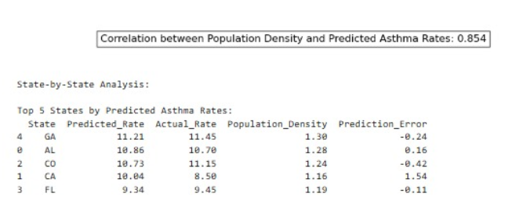
RESULTS
11

Slide 13
CONCLUSION
EDA FINDINGS:
Asthma rates clustered at 10-12% weak correlation with other variables, strongest with latitude (0.11).
TOP STATES:
Oklahoma, West Virginia, Maine had the highest mean asthma rates.
The top 5 states with the highest predicted asthma rates are GA, AL, CO, CA, and FL.
GWRF MODEL:
Asthma rates ranged from 8% to 16%, with a right-skewed distribution.
Used geographic, demographic, and statistical features; Gaussian distance weighting with 100 estimators.
MODEL PERFORMANCE (Georgia):
87.99% accuracy, -0.68% prediction error in Georgia
12

Slide 14
THANK YOU!

